Slide 1
Analysis of Variance
(ANOVA)
Chapter 11
Chap 11-<number>

Slide 2
Learning Objectives
In this chapter, you learn:
The basic concepts of experimental design
How to use one-way analysis of variance to test for differences among the means of several groups
How to perform multiple comparisons in a one-way analysis of variance
Chap 11-<number>

Slide 3
General ANOVA Setting
Investigator controls one or more factors of interest
  Each factor contains two or more levels
  Levels can be numerical or categorical
  Different levels produce different groups
  Think of each group as a sample from a different population
Observe effects on the dependent variable
  Are the groups the same?
Chap 11-<number>

Slide 4
Completely Randomized Design
Experimental units (subjects) are assigned randomly to groups
  Each group is assumed homogeneous
There is one factor or independent variable
  With two or more levels
Analyzed by one-factor analysis of variance (ANOVA)
Chap 11-<number>

Slide 5
One-Way Analysis of Variance
Evaluate the difference among the means of three or more groups
  Examples: Number of accidents for 1st, 2nd, and 3rd shift
  Expected mileage for five brands of tires
Assumptions
  Populations are normally distributed
  Populations have equal variances
  Samples are randomly and independently drawn
Chap 11-<number>

Slide 6
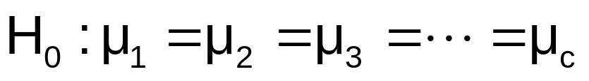
Hypotheses of One-Way ANOVA
  All population means are equal
  i.e., no factor effect (no variation in means among groups)
  At least one population mean is different
  i.e., there is a factor effect
  Does not mean that all population means are different (some pairs may be the same)
Chap 11-<number>

Slide 7
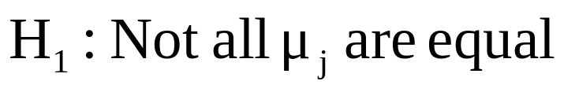
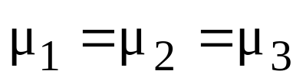
One-Way ANOVA
The Null Hypothesis is True
All Means are the same:
(No Factor Effect)
Chap 11-<number>

Slide 8
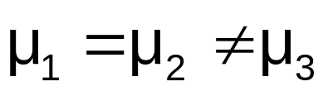
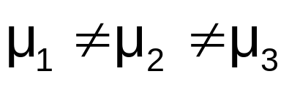
One-Way ANOVA
(continued)
The Null Hypothesis is NOT true
At least one of the means is different
(Factor Effect is present)
or
Chap 11-<number>

Slide 9
Method: Partitioning the Variation
Total variation can be split into two parts:
SST = SSA + SSW
SST = Total Sum of Squares
(Total variation)
SSA = Sum of Squares Among Groups
(Among-group variation)
SSW = Sum of Squares Within Groups
(Within-group variation)
Chap 11-<number>

Slide 10
Partitioning the Variation
(continued)
SST = SSA + SSW
Total Variation = the aggregate variation of the individual data values across the various factor levels (SST)
Among-Group Variation = variation among the factor sample means (SSA)
Within-Group Variation = variation that exists among the data values within a particular factor level (SSW)
Chap 11-<number>

Slide 11
Partition of Total Variation
Total Variation (SST)
=
Variation Due to Factor (SSA)
+
Variation Due to Random Error (SSW)
SSA = variation explained by different levels of the factor
SSW = variation not explained by the factor
Chap 11-<number>

Slide 12
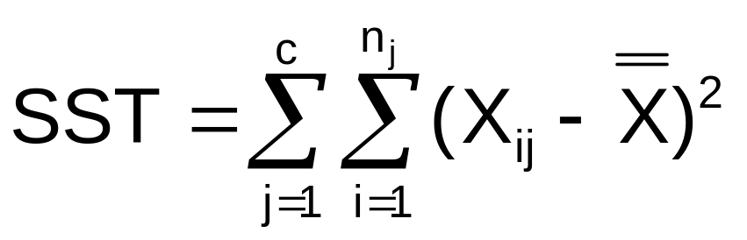

Total Sum of Squares
SST = SSA + SSW
Where:
SST = Total sum of squares
c = number of groups or levels
n_{j} = number of observations in group j
X_{ij} = i^{th} observation from group j
X = grand mean (mean of all data values)
Chap 11-<number>

Slide 13
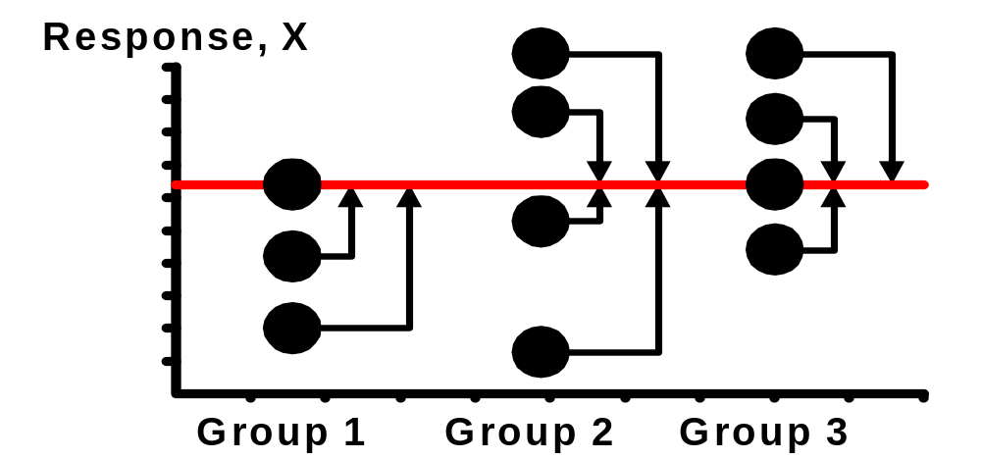
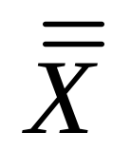
Total Variation
(continued)
Chap 11-<number>

Slide 14
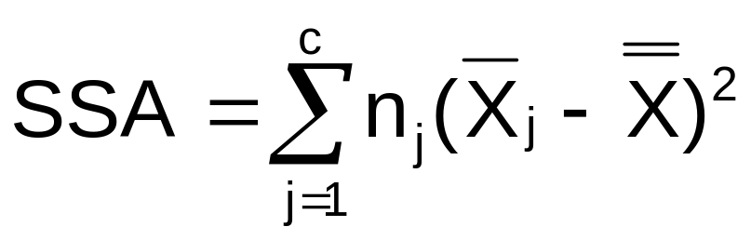
Among-Group Variation
SST = SSA + SSW
Where:
SSA = Sum of squares among groups
c = number of groups
n_{j} = sample size from group j
X_{j} = sample mean from group j
X = grand mean (mean of all data values)
Chap 11-<number>

Slide 15
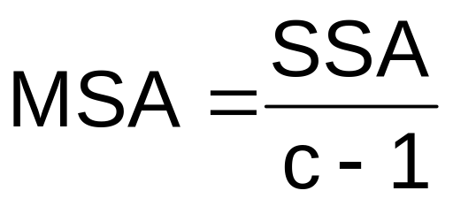


Among-Group Variation
(continued)
Variation Due to
Differences Among Groups
Mean Square Among = SSA/degrees of freedom
Chap 11-<number>

Slide 16
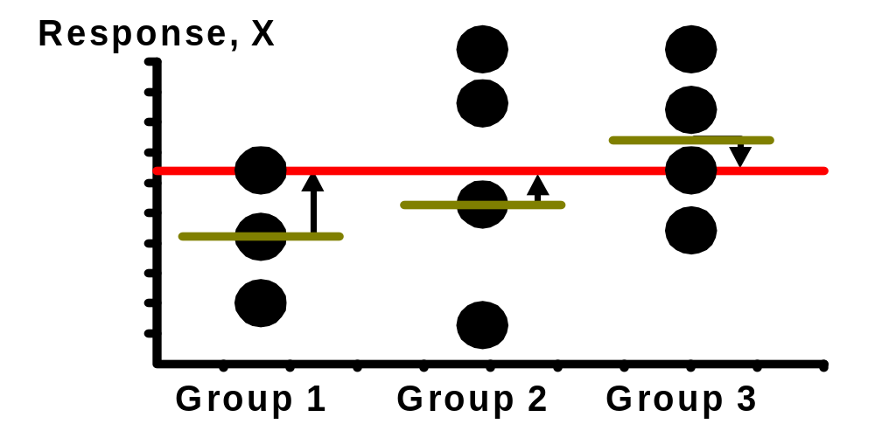
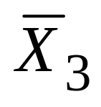
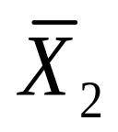
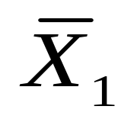
Among-Group Variation
(continued)
Chap 11-<number>

Slide 17
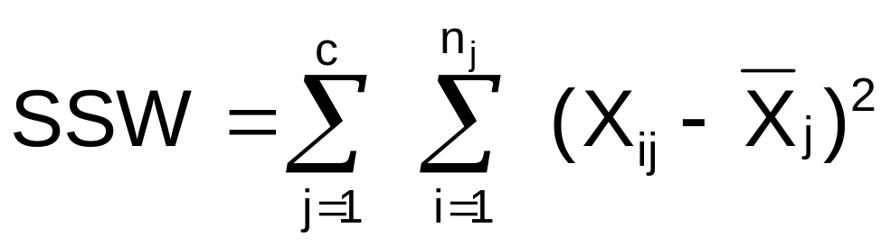
Within-Group Variation
SST = SSA + SSW
Where:
SSW = Sum of squares within groups
c = number of groups
n_{j} = sample size from group j
X_{j} = sample mean from group j
X_{ij} = i^{th} observation in group j
Chap 11-<number>

Slide 18
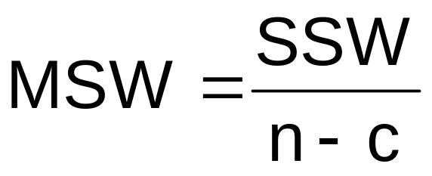

Within-Group Variation
(continued)
Summing the variation within each group and then adding over all groups
Mean Square Within = SSW/degrees of freedom
Chap 11-<number>

Slide 19
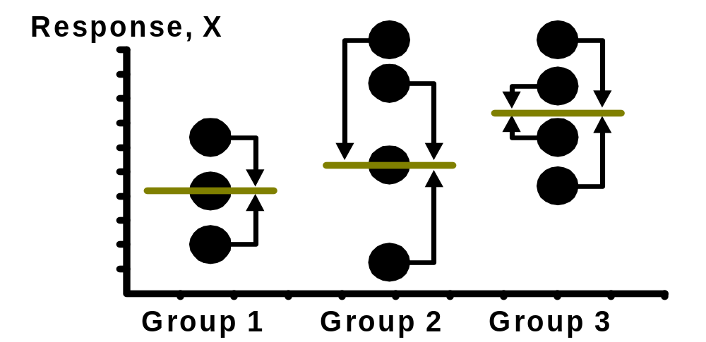
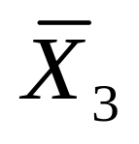
Within-Group Variation
(continued)
Chap 11-<number>

Slide 20

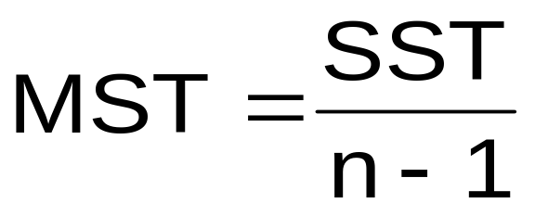
Obtaining the Mean Squares
The Mean Squares are obtained by dividing the various sum of squares by their associated degrees of freedom
Mean Square Among
(d.f. = c-1)
Mean Square Within
(d.f. = n-c)
Mean Square Total
(d.f. = n-1)
Chap 11-<number>

Slide 21
Examples
## 11.1, 11.2ab
Chap 11-<number>

Slide 22
One-Way ANOVA Table
Source of Variation
Degrees of
Freedom
Sum Of
Squares
Mean Square
(Variance)
F
Among Groups
SSA
F_{STAT} =
c - 1
SSA
MSA =
c - 1
MSA
Within Groups
SSW
n - c
SSW
MSW =
MSW
n - c
Total
n – 1
SST
c = number of groups
n = sum of the sample sizes from all groups
df = degrees of freedom
Chap 11-<number>

Slide 23
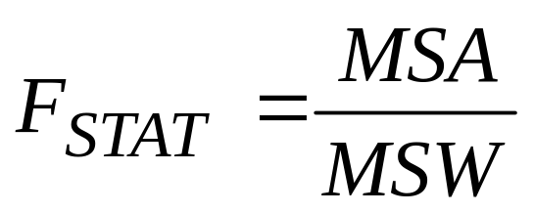
One-Way ANOVA
F Test Statistic
H₀: μ₁= μ₂ = … = μ_{c}
H₁: At least two population means are different
Test statistic
    MSA is mean squares among groups
    MSW is mean squares within groups
Degrees of freedom
  df₁ = c – 1 (c = number of groups)
  df₂ = n – c (n = sum of sample sizes from all populations)
Chap 11-<number>

Slide 24
Interpreting One-Way ANOVA
F Statistic
The F statistic is the ratio of the among estimate of variance and the within estimate of variance
  The ratio must always be positive
  df₁ = c -1 will typically be small
  df₂ = n - c will typically be large
Decision Rule:
Reject H₀ if F_{STAT} > F_{α}, otherwise do not reject H₀
α
0
Do not
reject H₀
Reject H₀
F_{α}
Chap 11-<number>

Slide 25
Examples
Page 401, ## 11.1-11.3
Page 401, ## 11.5-11.6ab
Chap 11-<number>

Slide 26
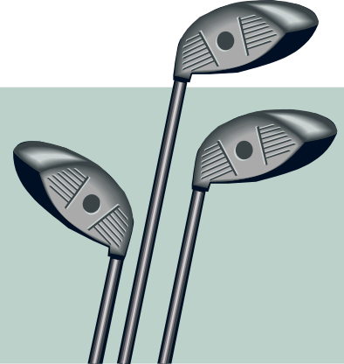

One-Way ANOVA
F Test Example
You want to see if three different golf clubs yield different distances. You randomly select five measurements from trials on an automated driving machine for each club. At the 0.05 significance level, is there a difference in mean distance?
Club 1 Club 2 Club 3
254 234 200
263 218 222
241 235 197
237 227 206
251 216 204
Chap 11-<number>

Slide 27
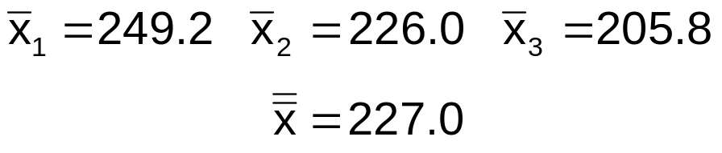
One-Way ANOVA Example: Scatter Plot
Distance
Club 1 Club 2 Club 3
254 234 200
263 218 222
241 235 197
237 227 206
251 216 204
270
260
250
240
230
220
210
200
190
•
•
•
•
•
•
•
•
•
•
•
•
•
•
•
1 2 3
Club
Chap 11-<number>

Slide 28
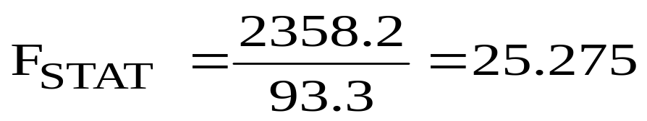
One-Way ANOVA Example Computations
Club 1 Club 2 Club 3
254 234 200
263 218 222
241 235 197
237 227 206
251 216 204
X₁ = 249.2
X₂ = 226.0
X₃ = 205.8
X = 227.0
n₁ = 5
n₂ = 5
n₃ = 5
n = 15
c = 3
SSA = 5 (249.2 – 227)² + 5 (226 – 227)² + 5 (205.8 – 227)² = 4716.4
SSW = (254 – 249.2)² + (263 – 249.2)² +…+ (204 – 205.8)² = 1119.6
MSA = 4716.4 / (3-1) = 2358.2
MSW = 1119.6 / (15-3) = 93.3
Chap 11-<number>

Slide 29
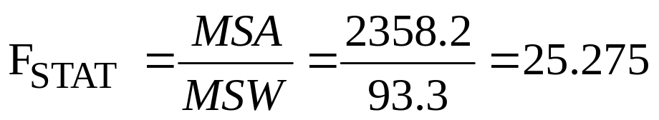
One-Way ANOVA Example Solution
H₀: μ₁ = μ₂ = μ₃
H₁: μ_{j} not all equal
α = 0.05
df₁= 2 df₂ = 12
Test Statistic:
Decision:
Conclusion:
Critical Value:
F_{α} = 3.89
Reject H₀ at α = 0.05
α = .05
There is evidence that at least one μ_{j} differs from the rest
0
Do not
reject H₀
Reject H₀
F_{α} = 3.89
F_{STAT} = 25.275
Chap 11-<number>

Slide 30
One-Way ANOVA
Excel Output
SUMMARY
Groups | Count | Sum | Average | Variance
Club 1 | 5 | 1246 | 249.2 | 108.2
Club 2 | 5 | 1130 | 226 | 77.5
Club 3 | 5 | 1029 | 205.8 | 94.2
ANOVA
Source of Variation | SS | df | MS | F | P-value | F crit
Between Groups | 4716.4 | 2 | 2358.2 | 25.275 | 0.0000 | 3.89
Within Groups | 1119.6 | 12 | 93.3
Total | 5836.0 | 14
Chap 11-<number>

Slide 31
Examples
Page 402, #11.12
Page 403, ## 11.13, 11.14 (using the Excel data analysis toolpak)
Chap 11-<number>

Slide 32
ANOVA Assumptions
Randomness and Independence
  Select random samples from the c groups (or randomly assign the levels)
Normality
  The sample values for each group are from a normal population
Homogeneity of Variance
  All populations sampled from have the same variance
Chap 11-<number>

Slide 33
Chapter Summary
In this chapter we discussed
The one-way analysis of variance
  The logic of ANOVA
  ANOVA assumptions
  F test for difference in c means
Chap 11-<number>

